Slide 1
Test Driven Development
Test a little, code a little, test a little, code a little, test, test, test, code a lot, test a little more.

Slide 2
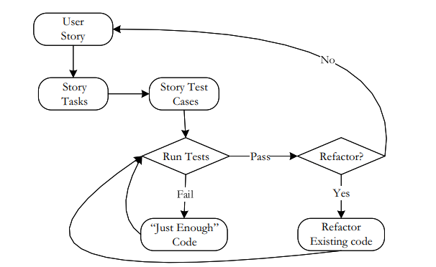
TDD?
Write a test case
Execute the test (it will fail** in absence of the corresponding code)
Write just enough code so that the test case passes*
Repeat 1 to 3 and observe the increase in code size
Refactor
Retest and make sure all the original test cases still pass
Repeat until no more testing is required
Doing just enough,
Always having a working (may be incomplete) version of the program
Fault isolation?
**here a failed test case means the actual output and the expected output do not match
*here a passed test case means the actual output and the expected output are consistent

Slide 3
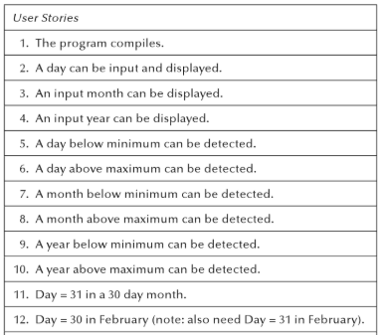
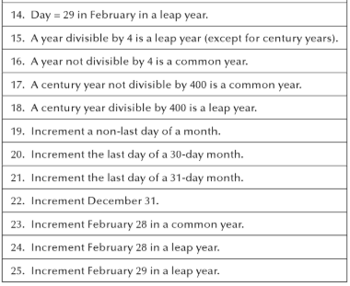
Example: Next Date Function
Guided by sequence of user stories
Dependent on order
Additional user stories

Slide 4


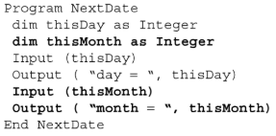
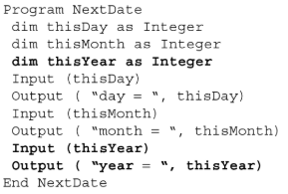
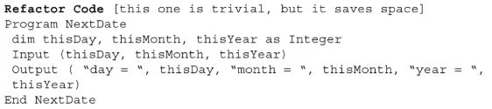
Example: Next Date Function
Id | User Story | Test Case | Corresponding Pseudo-Code
1 | The program compiles | Input: the NextDate source code EO: OK
2 | A day can be input and displayed | Input: 15 EO: day = 15
3 | An input month can be displayed | Input: 15, 11 EO: day = 15, month = 11
4 | An input year can be displayed | Input: 15, 11, 2005 EO: day = 15, month = 11, year = 2005

Slide 5
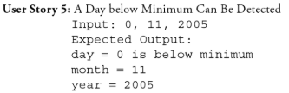
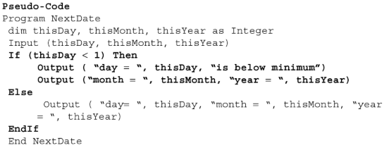
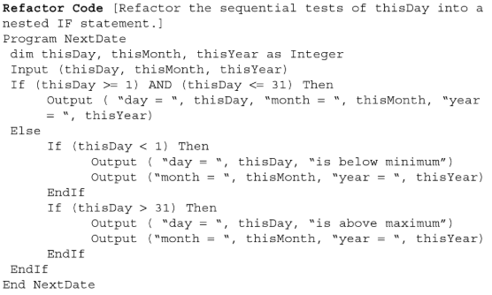
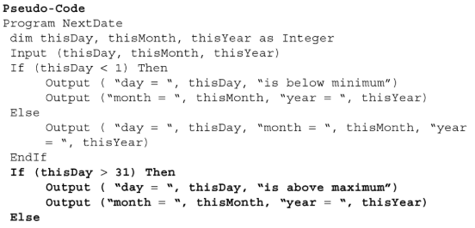
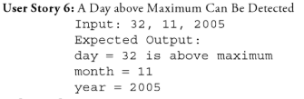

Example: Next Date Function (Contd.)

Slide 6
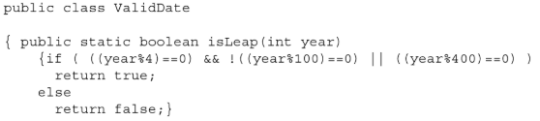
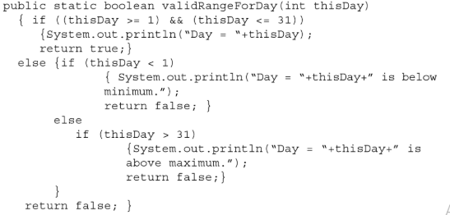
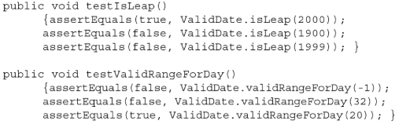
TDD
New test cases added to existing test suite with every user story
Code is refactored after every few tests
Tests are run in automated manner
Any problems/issues???
Code based or Specification based
Granularity of user stories
Configuration management?

Slide 7
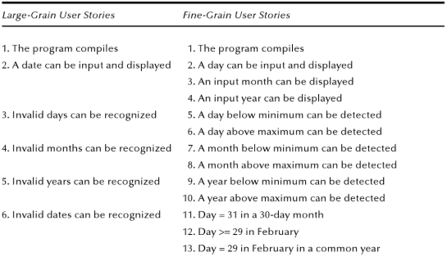
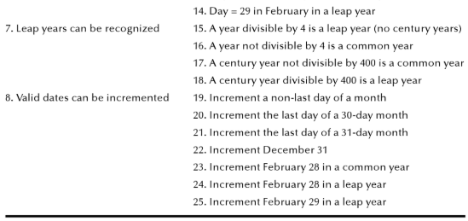
Granularity of Stories
Coarse Grain or Fine Grain?
Breakdown to finer

Slide 8
Discussion on TDD
A working system/program is always available (tight test/code cycles)
Fault isolation
Recreate a fault
Variety of frameworks available
Suitable for agile projects
Probably cleaner/simpler code (refactoring)
Skilled tester
Configuration management

Slide 9
Software Maintenance

Slide 10
Evolution
“Evolution is staged process of progressive change over time in the properties, attributes, characteristics, behaviour of some material or abstract, natural or artificial, entity or system” Darwin. Lehman.

Slide 11
The Changing System
Maintenance: any work done to change the system after it is in operation
Software does not degrade or require periodic maintenance
However, software is continually evolving
Maintenance process can be difficult

Slide 12
The Changing System Examples of Change During Software Development
Activity from which Initial change results | Artifacts requiring consequent change
Requirement analysis | Requirement specification
System design | Architectural design specification Technical design specification
Program design | Program design specification
Program implementation | Program code Program documentation
Unit testing | Test plans Test scripts
System testing | Test plans Test scripts
System delivery | User documentation Operator documentation System guide Programmer’s guide Training classes

Slide 13
Evolution vs Maintenance
Does the software evolve
What do we do to allow the evolution?

Slide 14
The Changing System The System Life Span
Will we need maintenance phase?
Even if best practices are followed, still need maintenance (because of E and P systems)
Development time vs. maintenance time
Recent surveys: 20% vs 80%
How much change can we expect?
System evolution vs. system decline: better to discard and build a new?
Cost/reliability/adaptability to change unacceptable?
Laws of software evolution

Slide 15
The Changing System Development Time Vs. Maintenance Time
Parikh and Zvegintzov (1983)
Development time: 2 years
Maintenance time: 5 to 6 years
Fjedstad and Hamlen (1979)
39% of effort in development
61% of effort in maintenance
80-20 rule
20% of effort in development
80% of effort in maintenance

Slide 16
The Nature of Maintenance Types of Maintenance
Corrective: maintaining control over day-to-day functions
Adaptive: maintaining control over system modifications
Perfective: perfecting existing functions
Preventive: preventing system performance from degrading to unacceptable levels

Slide 17
The Nature of Maintenance Who Performs Maintenance
Separate maintenance team
May be more objective
May find it easier to distinguish how a system should work from how it does work
Part of development team
Will build the system in a way that makes maintenance easier
May feel over confident, and ignore the documentation to help maintenance effort

Slide 18
The Nature of Maintenance Maintenance Team Responsibilities
Locating and correcting faults
Answering questions about the way the system works
Restructuring design and code components
Rewriting design and code components
Deleting design and code components that are no longer useful
Managing changes to the system as they are made
Understanding the system
Locating information in system documentation
Keeping system documentation up-to-date
Extending existing functions to accommodate new or changing requirements
Adding new functions to the system
Finding the source of system failures or problems

Slide 19
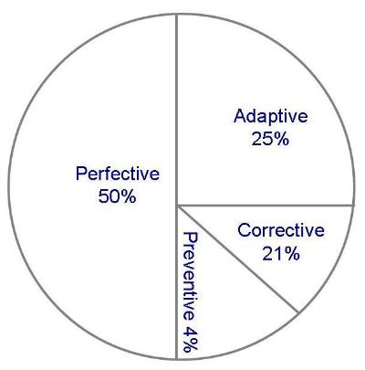
The Nature of Maintenance Use of Maintenance Time
Graphical representation of distribution of maintenance effort (Lientz and Swanson)

Slide 20
Maintenance Problems
Staff problems
Limited understanding (47% of effort is spent on understanding)
Management priorities: rushing a new product to the market
Technical problems
Testing difficulties (some systems must be available around a clock)

Slide 21
Maintenance Problems The Need of Compromise
Balancing need for change with the need for keeping the system available to users
Principles of SE compete with expediency and cost
Fixing problem quick but inelegant solution, or more involved but elegant way
Solving problem involves only the immediate correction of a fault

Slide 22
Some Common Integration Issues During Development

Slide 23
List of issues
1 | Inconsistent/different DB schema | 8 | Irrelevant code
2 | Inconsistent versions of libraries | 9 | Irrelevant attributes in db
3 | Inconsistent naming convention | 10 | Incomplete submission by coordinating teams
4 | Changes to code till the end | 11 | Skills of integration team
5 | Changes in Db schema till the end | 12 | Unavailability of single platform to receive codes to be integrated
6 | Independent/stand alone db | 13 | Inconsistent UI
7 | Inefficient communication between teams

Slide 24
Continuous Integration?

Slide 25
CI/CD
Continuous Integration and Testing
Main repository of code
Main repository of test cases (automated)
Merging of code changes at frequent basis (hourly/daily)
Execution of tests at each commit
Continuous Delivery and Deployment
Test suite with good coverage
Updated documentation
Automated deployment if a build passes the tests

Slide 26
Costs and Benefits of CI/CD
Costs
Writing automated test cases
Installation and maintenance of a server
Strong technical skills regarding testing
Strong testing culture required
Good documentation skills required
Benefits
Integration issues resolved early on
Issues are resolved before a developer moves from one task to another (better productivity)
Reduced testing cost over time (automated continuous testing?)
QA team can focus on managing consistencies in the process
Development do not need to be paused at the time of deployment
Less risky releases
Less pressure on teams

Slide 27
Continuous Testing?
Execution of test cases at each commit?
Automated execution of test cases at each commit?
TDD?

Slide 28
DevOps
Development and Operations
Shorten the lifecycle
Source code management
Continuous integration
Continuous testing
Use tool support

Slide 29
References
Paul Jorgensen, Software Testing-A Craftsman’s Approach, 3rd Edition

